Slide 1
Extreme Programming
TUHE 2017

Slide 2
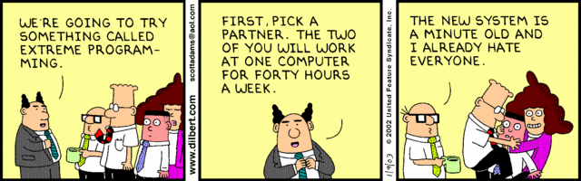

Slide 3
Extreme Programming
Know
The basics of XP as a development method
The 12 practices of XP
Be able to
Compare XP and Scrum
Describe differences and similarities
Describe conditions necessary for obtaining the stated benefits of XP
Explain how specific XP practices support the values in the agile manifesto
Explain how the individual XP practices can support each other

Slide 4
Resources
Kent Beck Extreme programming explained
Chap 1 Risk: The basic problem
Chap 4 Four Variables
Chap 10 A Quick Overview (practices)
Chap 11 How Could This Work?
Joshua Kerievsky The Extreme Programming Playbook https://www.industriallogic.com/wp-content/uploads/2005/09/xpplaybook.pdf

Slide 5
Economics of Software Development
We need to maximize the economic value of the project
Spend less - to save money
Earn more – make more money
Spending later and earning earlier
Pay less interest on the money spend
Increase the probability of project survival
The big problem is uncertainty.
Therefore the strategy must be:
Accurate and frequent feedback about progress
Many opportunities to change the requirements
A smaller initial investment

Slide 6
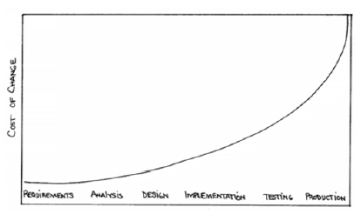
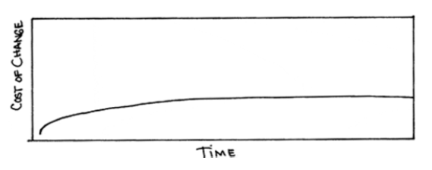
Cost of Change
Traditional view
XP view

Slide 7

Four Variables for Planning the Process
Cost
Scope
Time
Quality
Sees the "softness" of requirements as an opportunity, not a problem!
If we work in iterations with adaptable scope
Implement the customer's most important requirements first
We’ll be better at estimating
Be able to compare estimates with actual results

Slide 8
Extreme Programming - XP
Extreme Programming (XP) is a no nonsense, code first approach to software delivery that emphasizes four basic activities:
Coding
Testing
Listening
Designing
You code because if you do not code, you will haven’t done anything
You test because if you don’t test, you don’t know when you are done coding
You listen because if you don’t listen you don’t know what to code or what to test
You design so you can keep coding and testing and listening indefinitely

Slide 9
Overview
The Problem
Practices are concrete things that a team can do day-to-day
Values are the fundamental knowledge and understanding that underpins the approach
Values without practices are hard to apply and can be applied in so many ways that it's hard to know where to start
Practices without values are rote activities without a purpose.
The Metaphor
4 Values
Principles
4 Activities
12 Practices

Slide 10
4 (5)Values
The values must secure that the individual is oriented towards the interests of the project (common culture)
Communication
Make sure of continuous and relevant communication
XP practices are not possible without communication
Simplicity
Better to build simple solutions that will be changed than to build complex solutions that never are used
Feedback
“Optimism is an occupational hazard of programming” vs. “Don’t ask me – ask the system” (concrete feedback)
Courage
Be ready to change the system – even dramatically and late
Respect
Everyone gives and feels the respect they deserve as a valued team member

Slide 11
XP Practices 1-3
The Planning Game
The scope of the next release
Prioritized on the basis of business value and technical estimates
The costumer: Scope, prioritizing, sub deliveries
The developers: Estimates, technical consequences, a detailed plan (based on risk)
Small releases
Put simple system into production quickly
Small with large value for business
Metaphor
A shared understanding of the idea – substitutes architectures
Simple communication tool – naming concept of classes and methods

Slide 12
XP Practices 4-6
Simple Design
Use the simplest possible design that gets the job done.
The requirements will change tomorrow, so only do what's needed to meet today's requirements
Runs all tests
Avoids redundant code
Expresses important purposes
Has as few classes and methods as possible
Test
Continuously to reduce uncertainty
Programmers codeunit tests
Customers write acceptance/functional tests
Refactoring
Constant restructuring of the system without changing the behavior to improve code – to remove duplication, improve communication, simplify, add flexibility

Slide 13
XP Practices 7-9
Pair programming
Programming is a pair activity (driver & navigator roles)
Collective ownership
Not “no ownership”
Not “private” ownership
Anybody can change any code
Continuous integration
Integrate and build the system many times a day, every time a task is completed
Requires the tests to run after integration

Slide 14
XP Practices 10-12
40-hour week
Real productivity
On-site customer
Real live user on the team to answer questions
Coding standards
Eases communication through the code
Ideally, you shouldn't be able to tell by looking at it who on the team has touched a specific piece of code.

Slide 15
Focus in the Project on
Simple design
Testing
Collective Ownership
Refactoring
Continuous Integration
Pair Programming
Coding Standard

Slide 16
Relevant XP videos
Refactoring and test:
https://www.youtube.com/watch?v=vqEg37e4Mkw
Agile in general:
Small releases
Continuous integration
Pair programming
Feedback and communication
https://www.youtube.com/watch?v=GE6lbPLEAzc

Slide 17
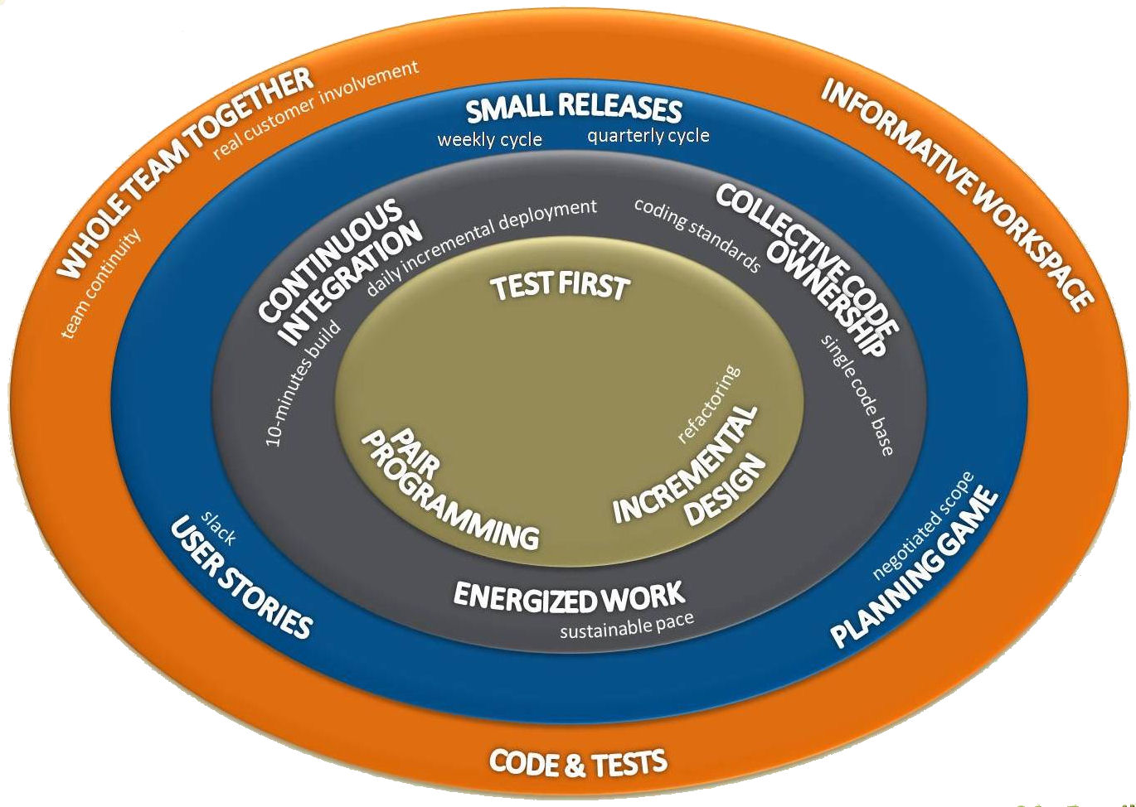

Slide 18
In class exercise
Time frame: 40 minutes
In groups, make a poster with the following elements
Title of selected practice
Your own experience with the practice – write name of person, and that persons experience level (0 – never used, 5 used it in job)
Select keywords for what you like about the practice
Select keywords for what you do not like about the practice
Make two suggestions for a 2 hour spike to test possible solutions on how to better the practice
Pick a presenter, we will go over these posters later
Pair programming
Simple design
Code standards
Refactoring
Collective ownership
Continuous integration
Test first
Small releases
Metaphor
On-site customer
40-hour week
Planning game

Slide 19
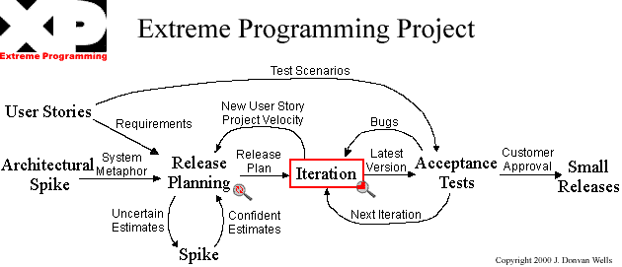
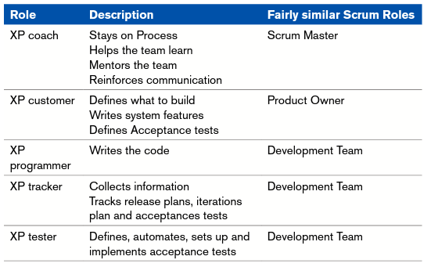
Extreme programming
http://www.extremeprogramming.org

Slide 20
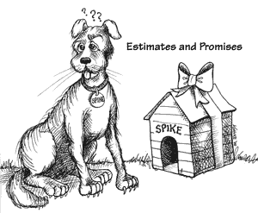
Spike
Create a spike solutions to figure out answers to tough technical or design problems.
A spike solution is a very simple program to explore potential solutions. Build the spike to only addresses the problem under examination and ignore all other concerns. Most spikes are not good enough to keep, so expect to throw it away.
The goal is reducing the risk of a technical problem or increase the reliability of a user story's estimate.
When a technical difficulty threatens to hold up the system's development put a pair of developers on the problem for a week or two and reduce the potential risk

Slide 21
User Stories
User stories serve the same purpose as use cases but are not the same.
They are used to create time estimates for the release planning meeting.
They are also used instead of a large requirements document.
User Stories are written by the customers as things that the system needs to do for them.
They are in the format of about three sentences of text written by the customer in the customers terminology without techno-syntax.
User stories should only provide enough detail to make a reasonably low risk estimate of how long the story will take to implement.
When the time comes to implement the story developers will go to the customer and receive a detailed description of the requirements face to face.
Try to keep stories focused on user needs and benefits as opposed to specifying GUI layouts

Slide 22
Release planning
A release planning meeting is used to create a release plan, which lays out the overall project.
The release plan is then used to create iteration plans for each individual iteration.
The essence of the release planning meeting is for the development team to estimate each user story in terms of ideal programming weeks.

Slide 23
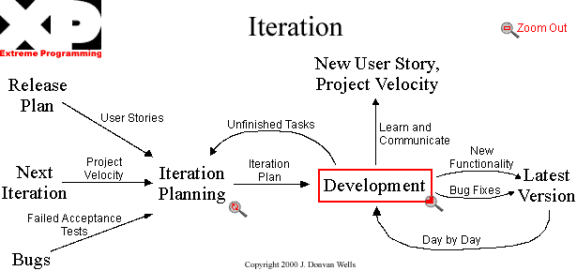
Iteration
http://www.extremeprogramming.org

Slide 24
Development
http://www.extremeprogramming.org

Slide 25
Acceptance Tests
Acceptance tests are created from user stories.
During an iteration the user stories selected during the iteration planning meeting will be translated into acceptance tests.
The customer specifies scenarios to test when a user story has been correctly implemented.
A story can have one or many acceptance tests, what ever it takes to ensure the functionality works.
Acceptance tests are black box system tests.

Slide 26
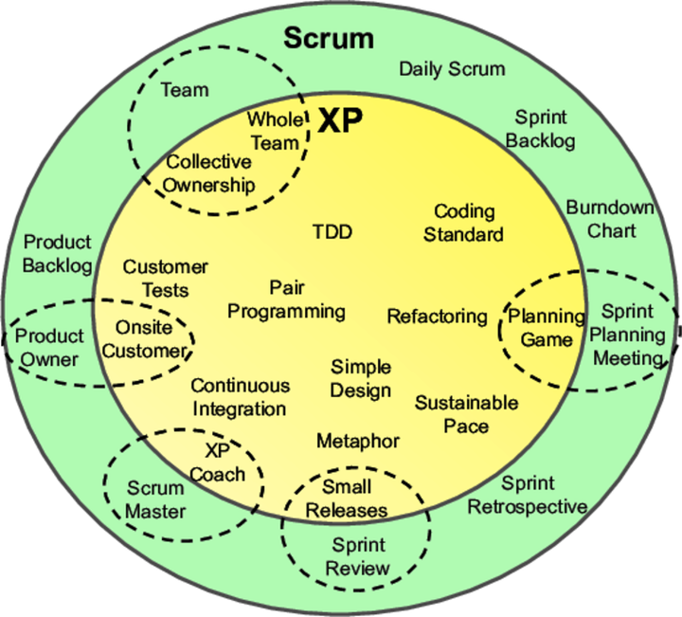
XP - Scrum
Agile projects often use combination
SCRUM for management
XP for development

Slide 27
XP - Scrum
Scrum teams typically work in iterations (called sprints) that are from two weeks to one month long. XP teams typically work in iterations that are one or two weeks long.
Scrum teams do not allow changes into their sprints. Once the sprint planning meeting is completed and a commitment made to delivering a set of product backlog items, that set of items remains unchanged through the end of the sprint. XP teams are much more amenable to change within their iterations. As long as the team hasn’t started work on a particular feature, a new feature of equivalent size can be swapped into the XP team’s iteration in exchange for the un-started feature.
Extreme Programming teams work in a strict priority order. Features to be developed are prioritized by the customer (Scrum’s Product Owner) and the team is required to work on them in that order. By contrast, the Scrum product owner prioritizes the product backlog but the team determines the sequence in which they will develop the backlog items.
Scrum doesn’t prescribe any engineering practices XP does.
Scrum focuses more on the management side of projects, extreme programming would focus more on the actual engineering practice.

Slide 28
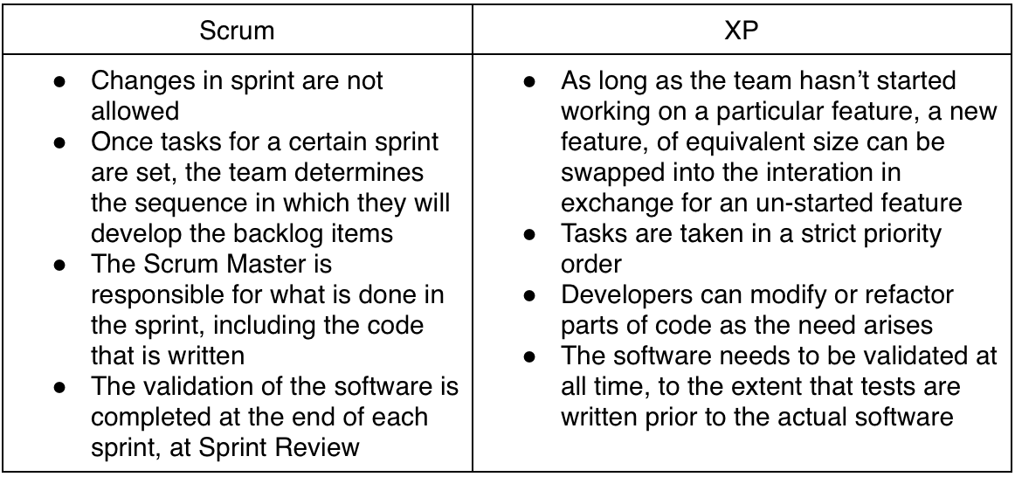
Differences Between Scrum and Extreme Programming

Slide 29
Exercises - Input to report
Plan – What do we intend to do?
Process - What did we do?
A good idea to make notes during the project
Reflection – What have we and others learned from this?
Start making a plan for how to use the XP practices

Slide 30
PPR - example Simple design
Plan for simple design:
The XP practice Simple design states that…
In our project we have planned to handle simple design by …
Process regarding simple design:
I the first sprint of the project we had a hard time keeping the design simple because …
In the next sprint we refactored the design so that …
We ended up with a design that …
Reflection over simple design:
It was our intent (see paragraph regarding plan for simple design) that we would handle simple design by …
But in the project we ended up by …
If we were to do a similar project again we would …
Generally speaking our experience with simple design is that …

Slide 31
Exercises
Act as the devil’s advocate towards these practices
Do they/don’t they work in real life?
Pick some favorites which you think sound promising
Argue for your choice
Define a set of coding standards for your future XP project
Pair programming
Why does it work better with

